Slide 1


Presentation for Criminal Justice Governing Board
Team Osprey
Technical Support
Raleigh, NC
PROPRIETARY INFORMATION – SENSITIVE
January 31, 2013

Slide 2


Mission Statement
Osprey Global Solutions delivers strategic access, leadership development, consultation, training and support services to the perpetual advantage of our partners, cognizant of humanitarian interest.

Slide 3



Tagging, Tracking, and Locating Devices (TTL)
Gun Safety
24-7 Real-Time Monitoring World-Wide Accountability Center; Track Simultaneously Web-Based:
Armatix
Quicklock - Mechatronic
Baselock - Multigun
Smart System - Personalized Handgun
21st Century Gun Safety
Inmarsat
Globalstar
Thuraya
Iridium
GSM
Forensics Consortium
Unmanned Air System
UNCW MARBIO Center
NFSTC
GARS - Alvarez & Marcel
Solkoa
Cyber Forensics 360
Osprey Forensics Italy, Milan
Proxy Aviation
Manned
Unmanned
For ISR, Damage Assessment, Tracking, Relay
SENSITIVE – PROPRIETARY INFORMATION

Slide 4

TTL Offerings

Slide 5
What Do We Offer?
Osprey Global Solutions LLC (“OGS”) provides a comprehensive solution for global Tagging, Tracking, Locating (TTL) of assets (personnel, vehicle, vessel, aircraft, equipment, and cargo). OGS offers sophisticated real time location-based asset monitoring capabilities globally for a wide range of industries and applications.
SENSITIVE – PROPRIETARY INFORMATION

Slide 6

Technology / Capabilities
Supported Global Comm Platforms:
  Iridium (Satellite network)
  Inmarsat (Satellite network)
  Global Star (Satellite network)
  GSM (Standard Cellular Networks)
World Wide Accountability Center (WWAC)
Osprey Global TRACKING Solution (OGTS)
  Web-based tracking solution
  Track multiple platforms all from one screen anywhere in the world
SENSITIVE – PROPRIETARY INFORMATION

Slide 7
Technology / Capabilities
Track by position, speed, altitude and heading
Tracking solutions specific to our clients requirements:
  Personnel tracking/text
  Vehicle tracking
  Vessel tracking
  Aircraft tracking
  Equipment
  Cargo tracking
SENSITIVE – PROPRIETARY INFORMATION

Slide 8
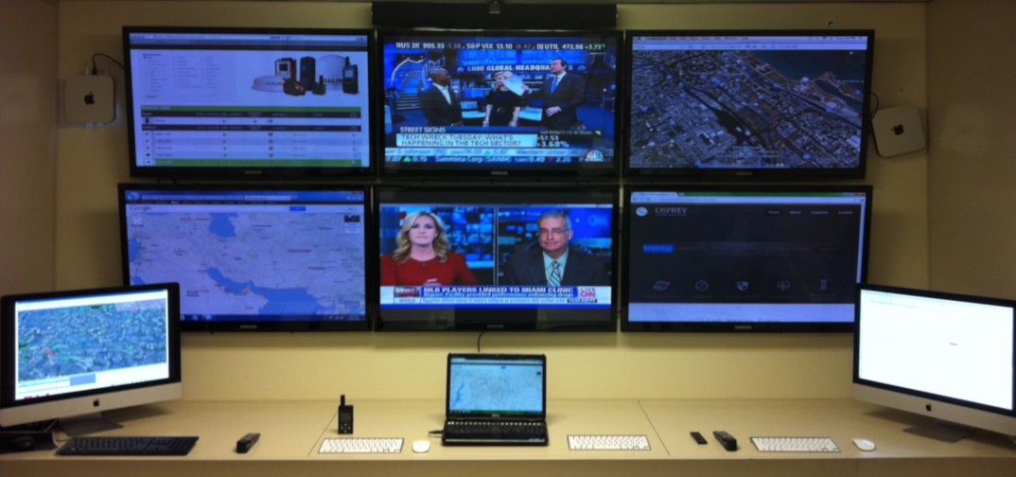
World Wide Accountability Center (WWAC)
The OGS World Wide Accountability Center (WWAC) is built to offer full spectrum TTL services providing 24/7 real-time monitoring and response capabilities for its clients.
Our multi-operational facility can track all devices simultaneously on one platform including:
  Inmarsat (Satellite network)
  Global Star (Satellite network)
  Iridium (Satellite network)
  GSM (Standard Cellular networks)
Can establish center at
client locations
SENSITIVE – PROPRIETARY INFORMATION

Slide 9
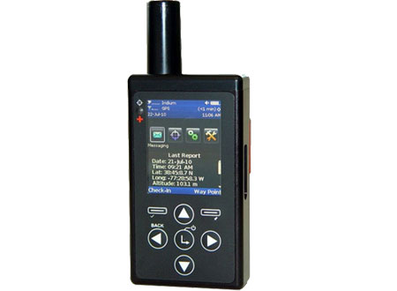
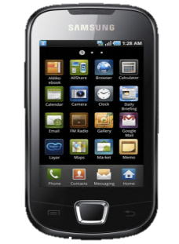
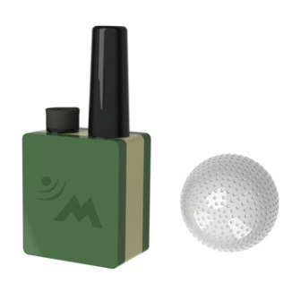
Osprey Global Tracking Solution (OGTS)
Web-based tracking solution
Track multiple platforms, all from one screen, anywhere in the world
Track by position, speed, altitude and heading
We provide tracking solutions specific to our clients requirements
  Personnel tracking
  Vehicle tracking
  Vessel tracking
  Aircraft tracking
  Equipment
  Cargo tracking
SENSITIVE – PROPRIETARY INFORMATION

Slide 10
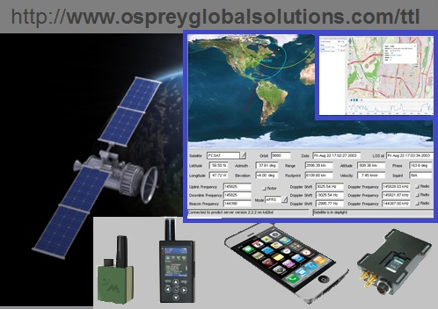
Four Product Categories
Handheld/Pocket/Belted Devices
  Self-contained including power source and antenna
Vehicle/Equipment Mounted (discreet/overt)
  Run off of existing power source often with internal power backup
Cell phone based VIP solution
  Software based solution can be discreet
  to prevent discovery
Specialized
  Gov’t Only
    Newest technologies
    Gov’t compliant
    Communications through gov’t
    comms/systems
  Private Sector Specialized Needs
    Micro sized
    Discreet
SENSITIVE – PROPRIETARY INFORMATION

Slide 11

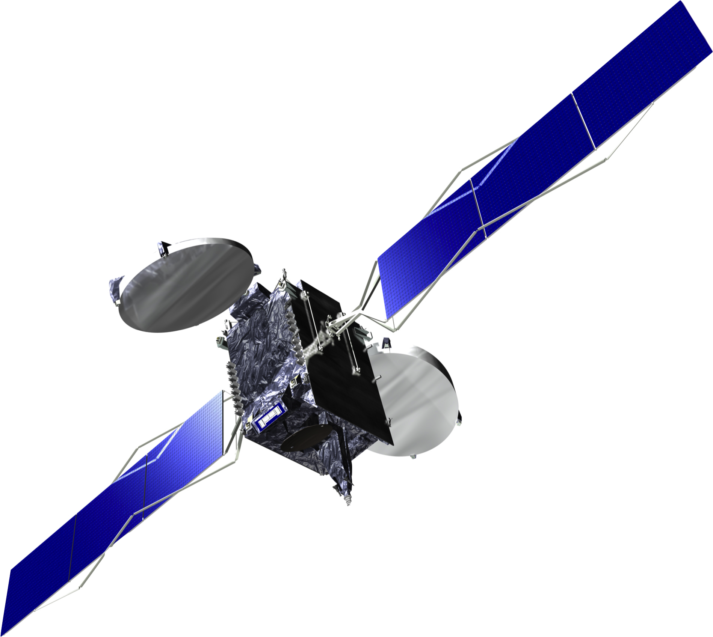

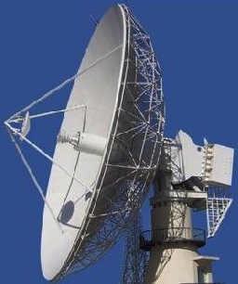

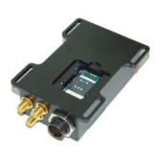
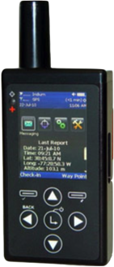
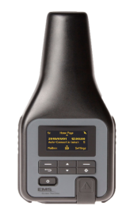
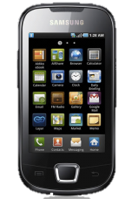

GSM
3G/4G
INMAR-Satellite
Iridium
I-Direct Satellite
GPS Satellite
Transmit
Receive
Iridium Ground Station
NAL VA, USA
Transmit
Transmit
Transmit
Transmit
WWW
Fiber Optic
Receive
Receive
Receive
WWW
Fiber Optic
Receive
Trans-Atlantic Fiber
OCONUS
Data Server
CONUS
Data Server
OCONUS
Data Server
CONUS
Data Server
OCONUS
Data Server
OCONUS
Data Server
Government Center
Commercial Center
Wilmington, NC
Osprey World Wide Accounting Center
Italy
Osprey World Wide Accounting Center

Slide 12
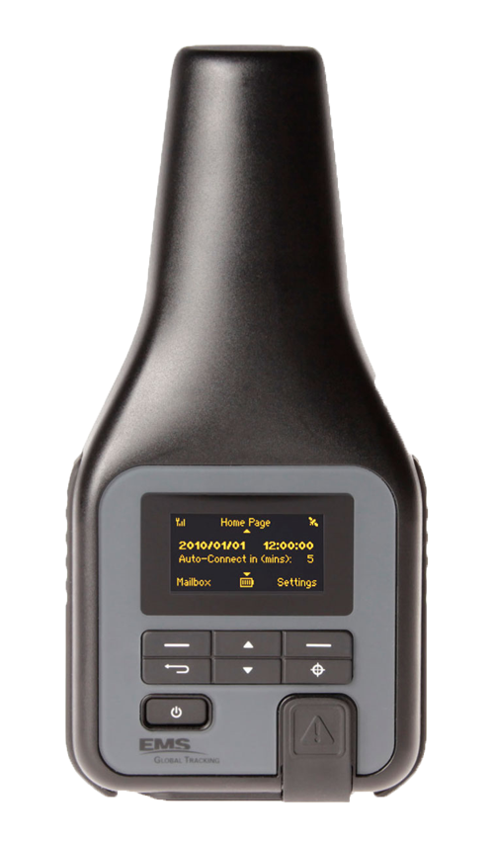
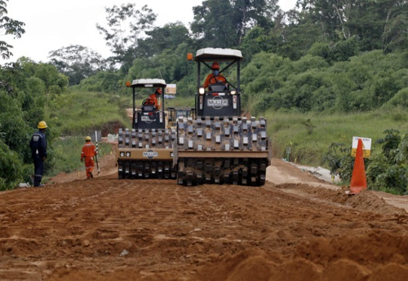
NAL SATELLITE PRODUCTS – 960X MODEMS:
9602-N:
DESCRIPTION Model 9602-N is a satellite modem designed to operate with the Iridium network in SBD-only mode. Similar to a standard land-line modem, the 9602-N can be controlled by a data terminal equipment (DTE) capable of sending AT commands via an RS232 serial port. A DTE can be a desktop computer, a laptop computer, a PDA, or even a micro-controller.
SPECIFICATIONS
Dimensions: 71 mm x 48 mm x 23 mm (2.81" x 1.90" x 0.91")
Weight: 136 g (4.8 oz)
Input Voltage: 4.5VDC to 5.5VDC or 6.5VDC to 32.0VDC
Avg. Current: 190mA @ 5VDC Input
I/O Interfaces: 15-Pin D-Sub
Antenna Interface: SMA Female
Software Interface: AT Commands through RS232
Operating Temp: –40°C to +85°C (–40°F to +185°F)
Operating Humidity: < 75% RH
Operating Frequency: 1616 to 1626.5 MHz
Link Margin (Uplink): 7 dB
MANUALS Product Information, AT Commands Manual, User’s Manual

Slide 13
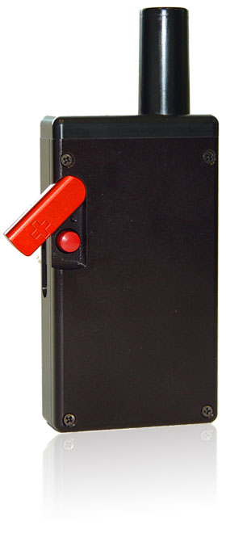
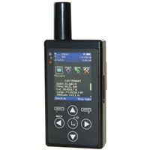
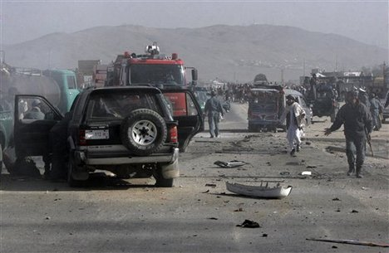
SHOUT Nano:
DESCRIPTION The SHOUT nano is our second-generation handheld satellite tracker and messaging device. It is about 45% smaller than then the SHOUT and weighs half as much while retaining all the functions and features of the SHOUT. The nano has a high resolution color LCD with menu options displayed as icons instead of line-text.
The nano is designed with ultra-low power consumption electronics drawing less than 35µA during sleep. With an internal 1.95 A-Hr rechargeable Li-Ion battery, it can send a position report every hour for up to two months (about 1,500 reports). The SHOUT nano is equipped with on-screen keyboards supporting transmission of free-text, canned messages and a combination of free-text and canned messages. The device can periodically wake up from sleep to send its position report to a command center. A guarded 911 button is used for immediate emergency/alert notifications. Data are packaged in either standard or 256-bit AES encrypted format.
SPECIFICATIONS
Dimensions: 102 mm x 56 mm x 20 mm (4.0" x 2.2" x 0.8")
Weight: 184 g (6.5 oz)
Battery: Rechargeable Li-Ion
1.95 A-Hr Single Cell
3.6VDC to 4.2VDC
I/O Interfaces: Standard USB
Software Interface: AT Commands through USB
Operating Temp: –40°C to +85°C (–40°F to +185°F)
Operating Humidity: < 75% RH
Operating Frequency: 1 1616 to 1626.5 MHz
Link Margin: 1575.42 MHz (L1 carrier)
MANUALS Product Information, User’s Guide, SAR Certification

Slide 14
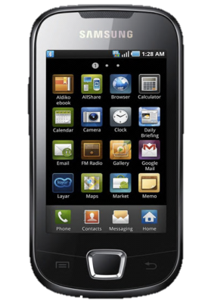
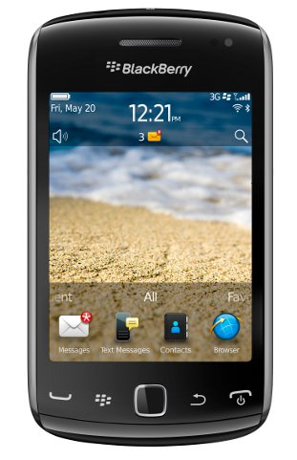
Executive Tracker
SUMMARY
The Executive Tracker is a software based covert tracking system ideal for VIP’s. The software can be installed on most modern cell phones and requires no physical changes to the phone or cell plan. The phone continues to operate without visible indication of the software's presence.
The Executive Tracker can be operated anywhere there is standard GSM cellular connectivity.
The Executive Tracker has a 911 panic button which can be easily activated by pressing 3 keys in a specific manner. The alert signal remains covert even after activation.
TECHNOLOGY/CAPABILITY
Utilizes standard GSM/SMS cellular communication
Utilizes the phones on board GPS chip to retrieve current location data (phone chip retrieves data from GPS satellites)
When satellites are not available, approximate location can be obtained based on cellular tower triangulation
Software remains covert and does not show in the running apps menu
Contact Osprey TTL Tech to determine a specific phones fit for this product.
Iphones can be supported but are not recommended as they require significant technical on-going support to maintain service

Slide 15
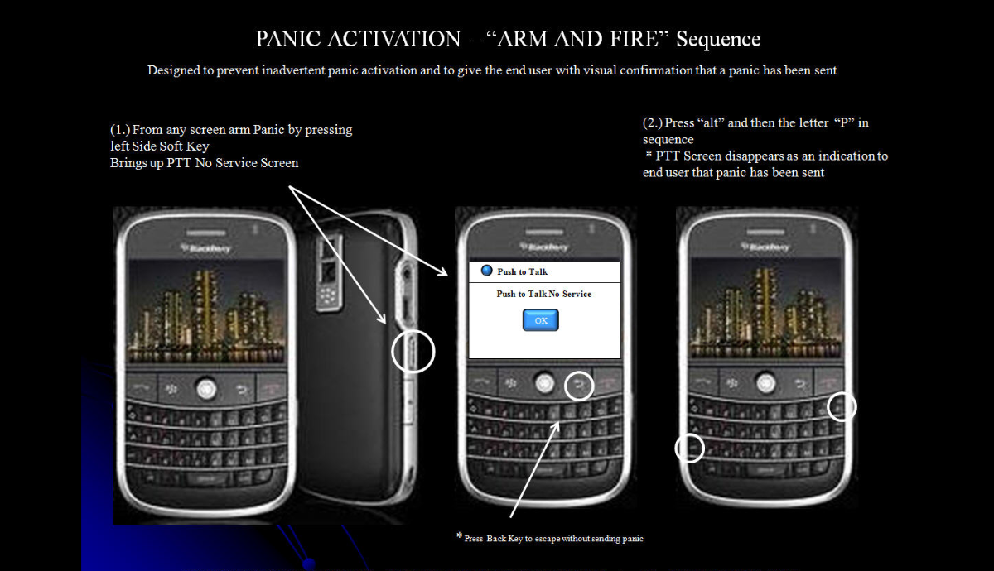

Slide 16
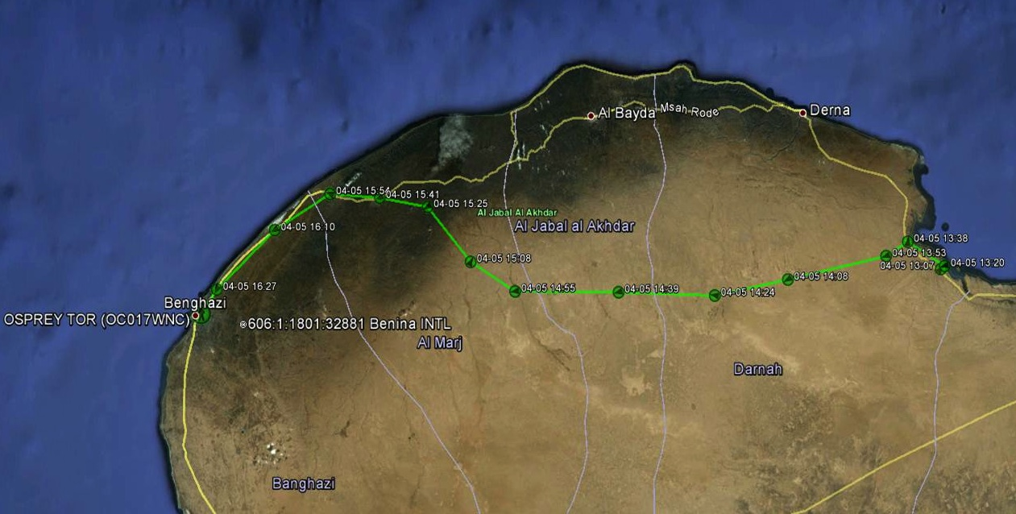
Libyan Trip
SENSITIVE – PROPRIETARY INFORMATION

Slide 17
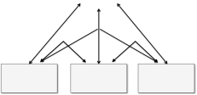

Potential Scenarios:
Hazmat Site
School Emergency
Man-made Disasters
Natural Disasters
National Guard
Benefits:
Reliable, uninterrupted coordination between sites regardless of geographical challenges
Radio Backup
Send Text
SATELLITE
Firefighter
EMT
Law Enforcement Agency Patrol Car
On-Scene
Law Enforcement
Law Enforcement Agency Station
SENSITIVE – PROPRIETARY INFORMATION

Slide 18
Unmanned Air
Systems

Slide 19
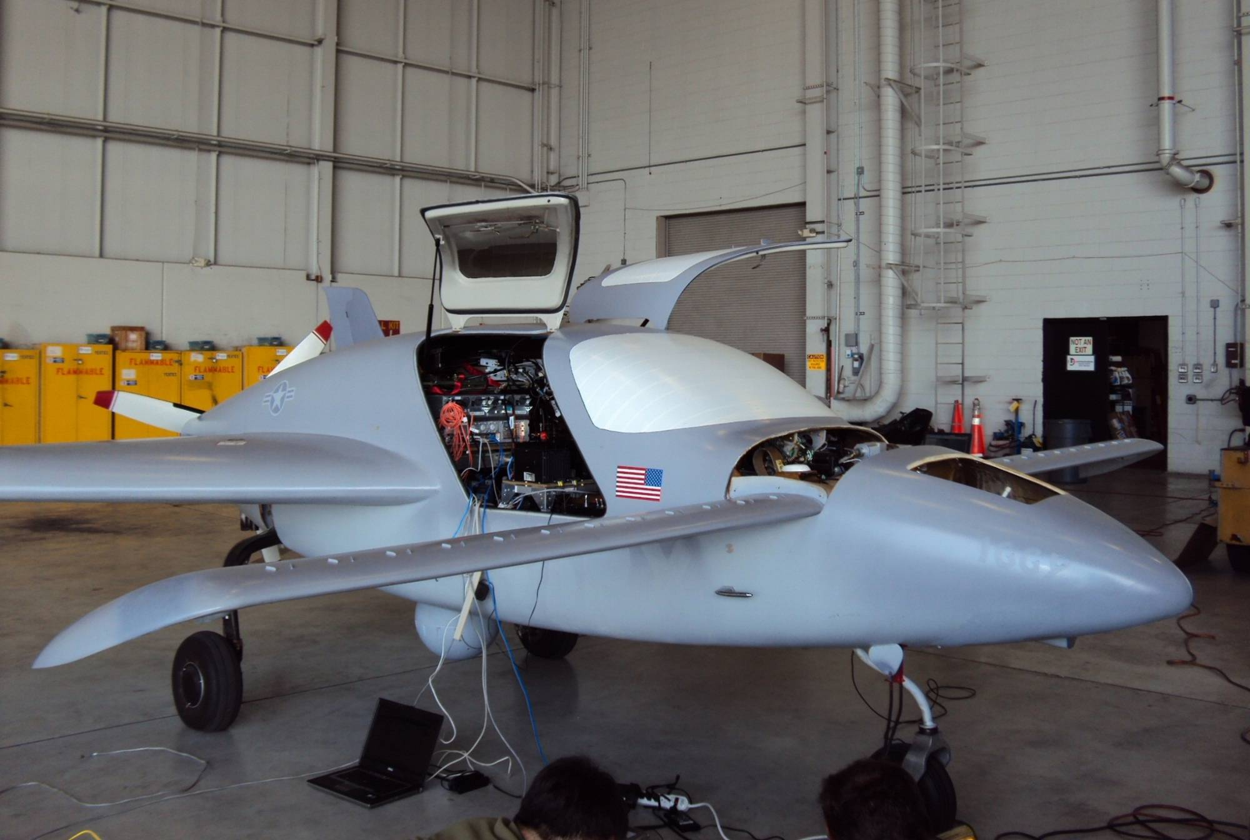
Proxy Technologies – Osprey Global Solutions
Notes:
19

Slide 20
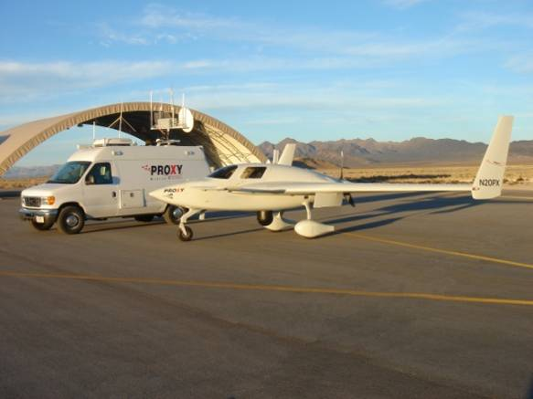
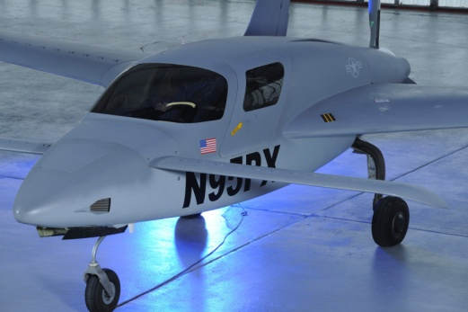
Proxy Capabilities
Turnkey Optionally Piloted Aircraft (OPA)systems
based on the SkyRaider® airframe
  Portable Ground Control System
  (Vehicle or portable rack mounted)
  Aircraft can be disassembled and reassembled
  by 3 technicians
  FAA approved OPA
  Cost Effective
SkyRaider® high lift capacity, low operating
cost aircraft
  Capacity for 20+ hours of endurance
  1700 lb lift capacity
  Speed range 80 – 150 kts
  Allows simultaneous deployment of
  multiple sensor systems
  Interoperable payloads

Slide 21
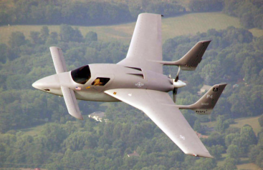
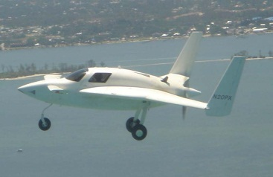
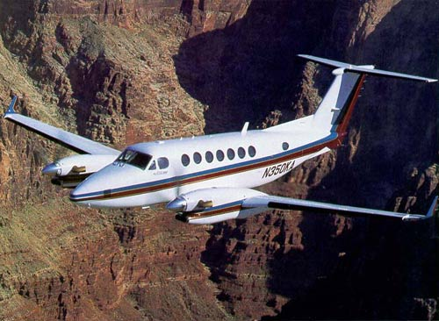
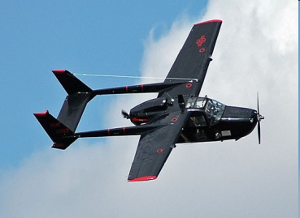

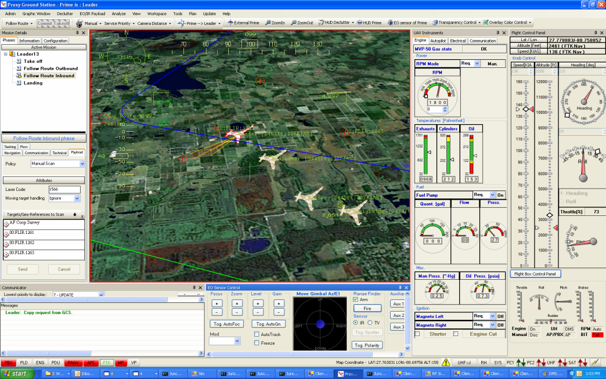
Universal Distributed Management System (UDMS™)
Key Technology
Autonomous vehicle & Optionally Piloted control
Multiple vehicle cooperative engagement from a single mission manager, exploits complementary sensors
Advantages
Operator controls payload - system navigates the vehicle
Operated/maintained by a fraction of the manpower required for existing UxSs
Not limited to a specific vehicle, sensor or comm. system
FAA approved approach to convert existing aircraft to autonomous flight control
Missions can be modified on the fly
Adaptive prioritized target list, integrated into existing command & control networks
600+ hours tested and flown in autonomous mode
UDMS™ currently operates on SkyRaider® and Velocity
Trade studies conducted on King Air, SkyMaster and Caravan
Screenshot of UDMS™ Control Station shows control of 4 aircraft

Slide 22
Universal Distributed Management System (UDMS™)
GCS Capabilities
Command, control and monitoring of up to 32 vehicles and control stations
Pre-mission planning, simulation, modeling & rehearsal
In simulation mode system faults can be artificially injected into the system and engineering analyses can be performed
Post-mission playback and engineering analyses
Capable of functioning with real vehicles & sensors interacting with simulated vehicles & sensors
Two way control for forward users – can control the sensors and the vehicle
UDMS™ currently operates on SkyRaider® and Velocity
Trade studies conducted on King Air, SkyMaster and Caravan
Screenshot of UDMS™ Control Station shows control of 4 aircraft

Slide 23
UDMS™ Capabilities
One operator can simultaneously manage multiple vehicles and sensors each performing different missions.
  Survey Points of Interest
  Watch and Follow
  Road Patrol with Cooperative Tasking
Standard vehicle behavior is preplanned. Operator commands the vehicles at a high level.
  Assigns the mission
  Approves actions requested by assets
The vehicles intelligently and cooperatively perform the mission and execute their assigned tasks.
UDMS™ is easy to use and easy to learn – the operator acts more as a mission manager than a vehicle controller.
23

Slide 24
Video
Aircraft P2,P4, S1 and S2 are patrolling or surveying a route. An emitter causes the aircraft to investigate a specific area.
In this video, the operator will only approve aircraft request as the emitter triggers a response from the aircraft patrolling a road.
This scenario demonstrates the ease with which a single operator can manage sensor alerts to reassign vehicles and sensors. Multiple vehicles can work together to accomplish mission requirements when using Proxy’s UDMS™.
This is an example of a military style mission. Nearly all the technologies demonstrated in the following video can be adapted for civilian use.

Slide 25
Route Patrol Video
The video is a screen capture of the Proxy Ground Station running UDMS™ controlling four aircraft flying in the National Airspace (NAS) in the Washington DC area.
In this video, the operator is focusing on the aircraft flying route patrol mission. The four aircraft will cooperatively execute a mission based on a trigger from a randomly placed surface emitter.
Run Video

Slide 26
Other Applications
Criminal Activity
Law Enforcement and Citizen Safety
Search and Rescue
Fugitive recovery
Natural Disaster Response
  Pre and Post Mapping
Situational Awareness
Osprey Global Solutions TTL integration
Asset Management

Slide 27
Gun Safe

Slide 28
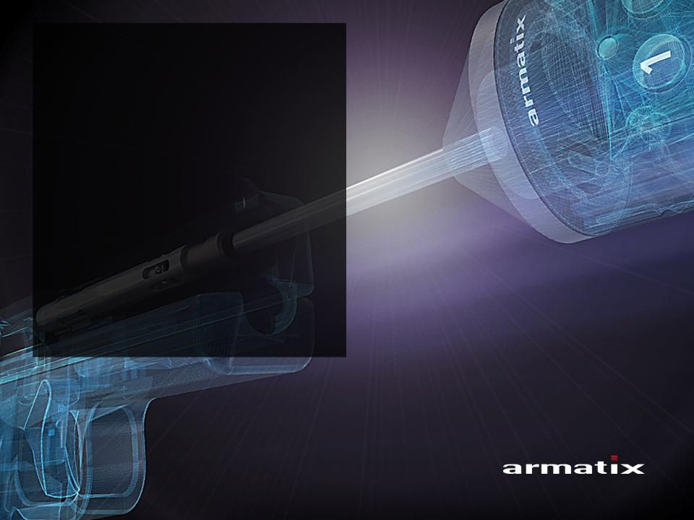
21ST CENTURY
GUN
SAFETY

Slide 29

21ST CENTURY GUN SAFETY
This is my gun cabinet!

Slide 30
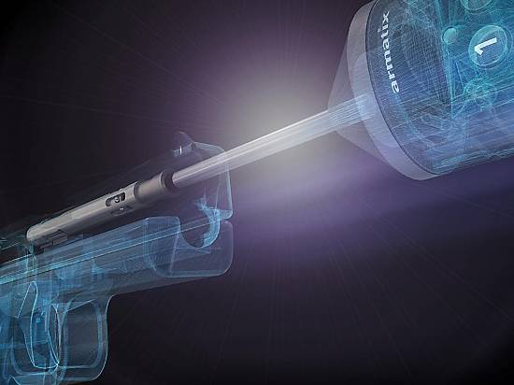
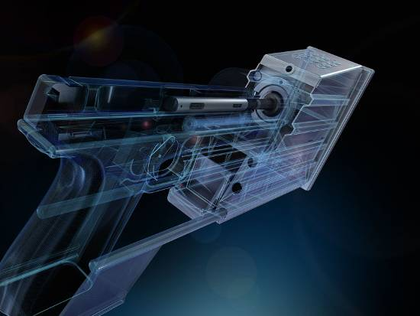
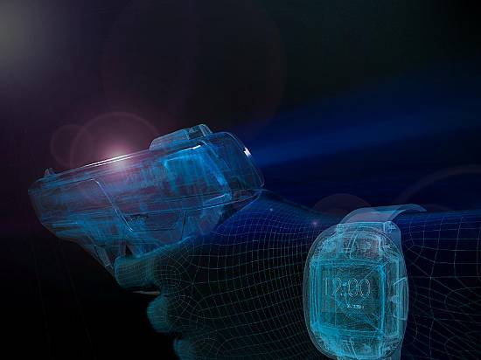
PRODUCT GROUP OVERVIEW
QUICKLOCK
BASELOCK
SMART SYSTEM
The first mechatronic
gun safety mechanism worldwide.
The new multi-gun safety storage device.
The future of the firearm. Now.

Slide 31


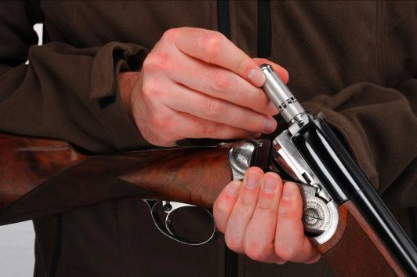
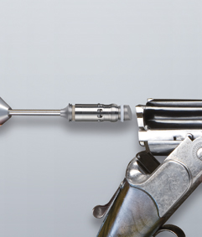
QUICKLOCK:
SAFE IN SECONDS
EASIEST HANDLING
1
(2)
(3)
2
3
Control Unit with
Locking Elements
Introduction in the chamber – automatic locking
Removal of locking device after proper authentication at the control unit

Slide 32
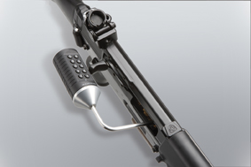
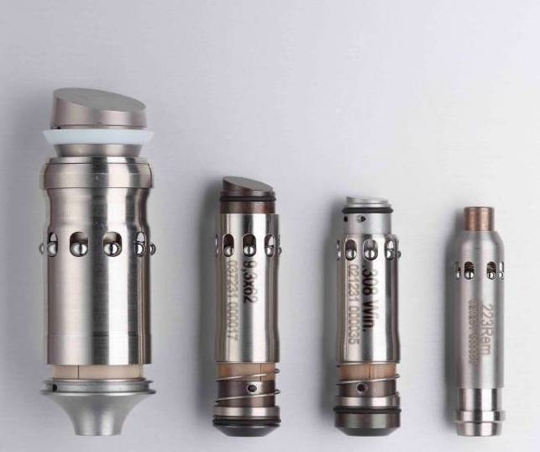
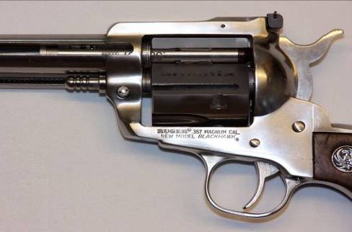
QUICKLOCK:
SAFE, FAST and EASY
GUARANTEED DAMAGE FREE
Notes:
32

Slide 33
ADVANTAGES OF QUICKLOCK
AT A GLANCE
  Stolen guns are unusable (1.4 Million firearms were stolen in the US from 2005 to 2010. An average of 186k firearms per year are never recovered and sold in the black market.
  No unauthorized person can use the gun
  Unauthorized removal of the Armatix locking cartridge irreparably destroys the gun
  Top security during transportation and storage of the gun
  Locking mechanism can only be released by means of valid PIN or biometric authentication
  Gun and control unit are shipped separately
  Code can be transmitted from a secured computer at headquarters via online connection (Certification Center)
  Fewer staff needed for gun transportation
  Safety features visible or not visible

Slide 34
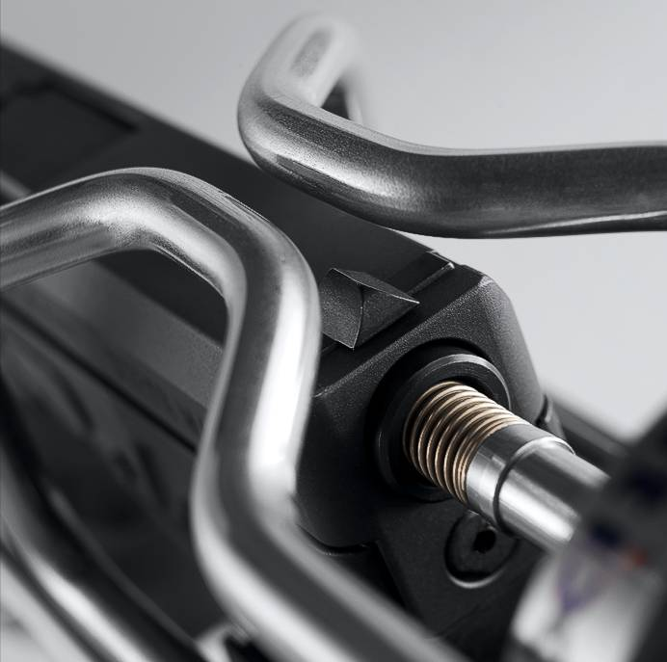
BASELOCK:
THE NEW MULTI-GUN SAFETY
STORAGE DEVICE
Top security for stationary
or mobile gun storage.
(In US courts, in armories, in gun cabinets, in vehicles, in stores,
at trade fairs, at shooting ranges, etc.)
  Protection for all known short guns including their magazines
  Modular system – combination of any number of modules
  Guns in one module unit are individually secured
  Modules are able to secure various calibers
  User and time are logged
  Centralized release possible – extremely short access times

Slide 35
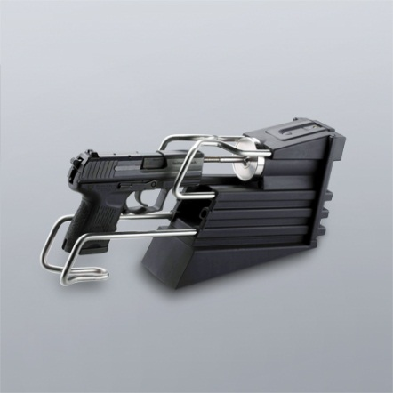
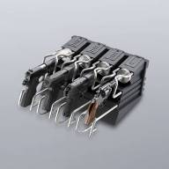
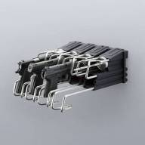
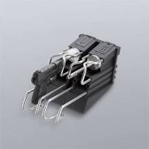
BASELOCK:
ONE SYSTEM – MANY APPLICATIONS
SEPARATE
LOCATION
MULTIUSER LOCATION
WALL MOUNTING
TABLE MOUNTING

Slide 36
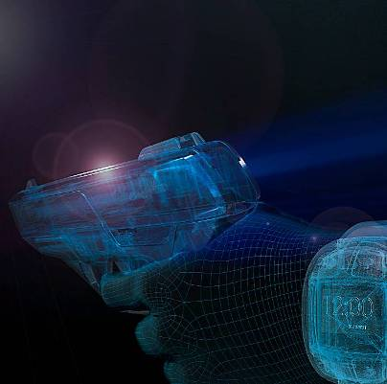
SMART SYSTEM:
THE FUTURE OF THE FIREARM. NOW.

Slide 37
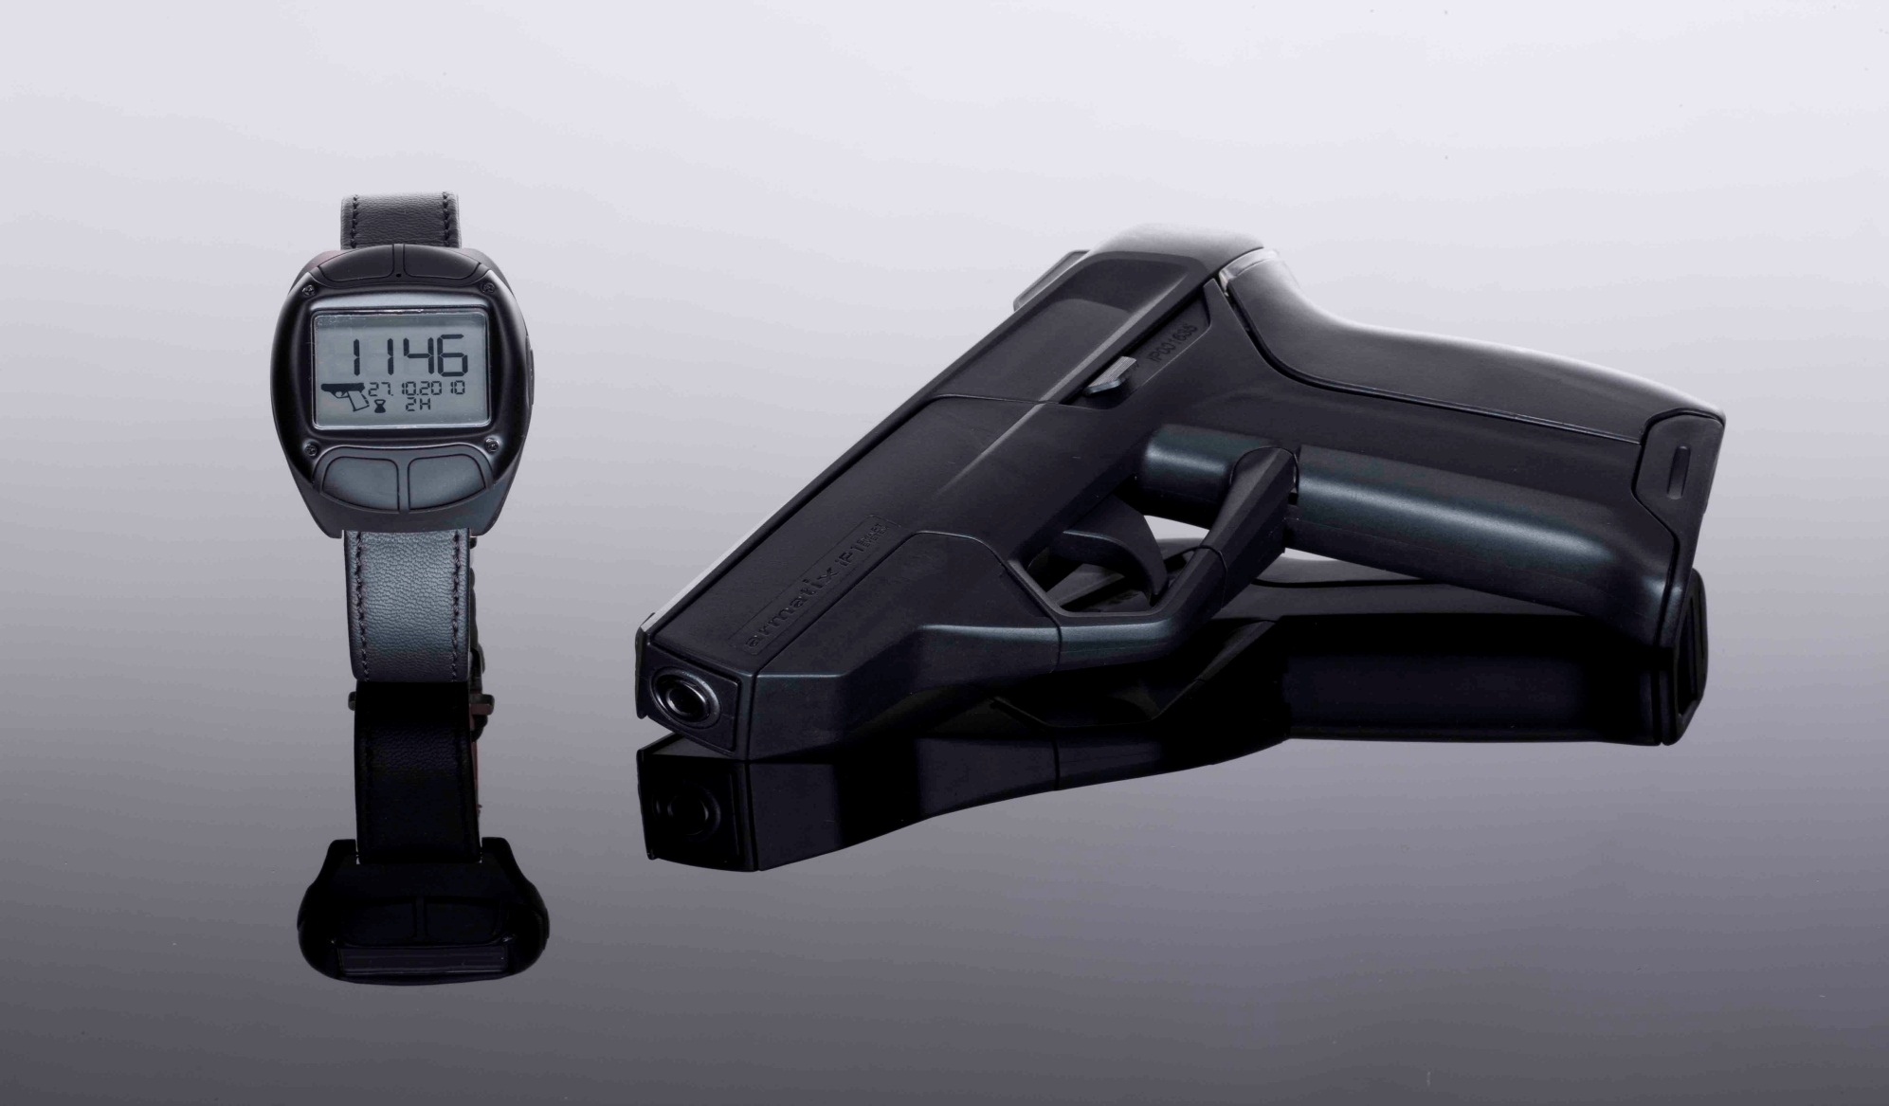

SMART SYSTEM iP 1
PERSONALIZED HANDGUN
ATF approved the iP1 for Importation in December 2011

Slide 38
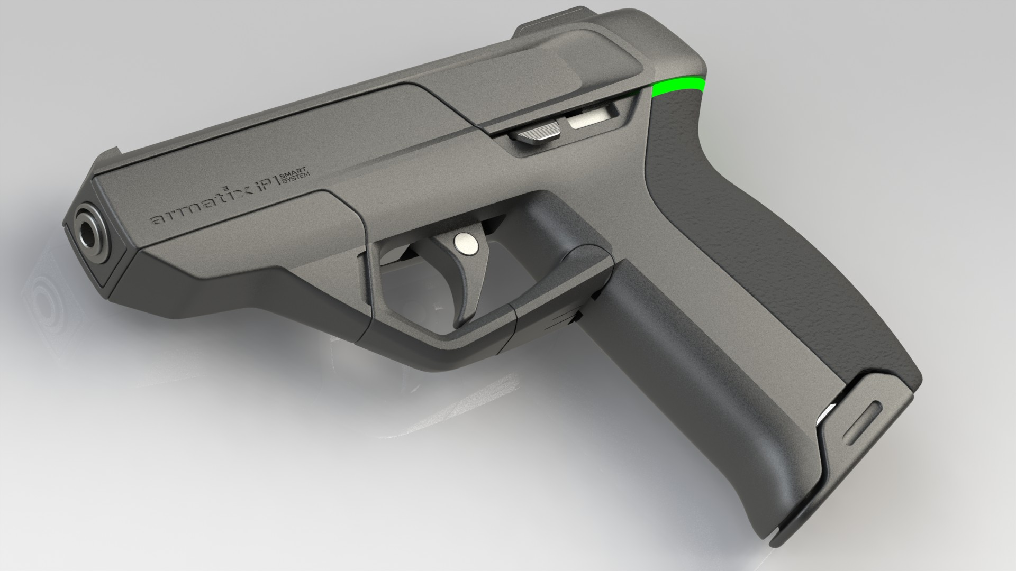
SMART SYSTEM: iP1: THE NEXT LEVEL OF FIREARM
  Only authorized people can use the firearm
  Activated to shoot, if System Watch is within range
  Automatic firearm disabling in case of
  - Loss of Firearm
  - Theft
  - Snatched by Aggressor
  Integrated electronically controlled actuation enables absolutely secure release and locking of the Firearm
  Armatix Smart System can be applied to a high number of handguns and other weapons systems

Slide 39
Gun Safe Summary
Osprey has teamed with Armatix™ and will present and demonstrate to select groups in USA
Gun Safe provides solutions to security and safety challenges as well as the ongoing controversy in USA
Systems are now used in Europe
SENSITIVE – PROPRIETARY INFORMATION

Slide 40
Forensics

Slide 41
Cyber Forensics 360
SOLKOA
Osprey Forensics Institute & Lab-
Milan, Italy
Global Asset Recovery Services Alvarez & Marcel
National Forensic Science Tech Center
Forensics Consortium
American Communications (IT-TELECOM)
Osprey Investigative Services
Osprey Business Intel Services
Osprey Laboratory
MARBIONC – Crest Center UNCW
Osprey Protective Security Services
SENSITIVE – PROPRIETARY INFORMATION

Slide 42
Forensics
Objective
To establish a forward presence combined with state-of-the art, multi-disciplined forensic technologies to support the gathering and custody of evidence, the development of intelligence, and the execution of an action plan associated with operations for a multitude of venues, both foreign and domestic.
Investigations and Intelligence
Foresic Finacial Accounting Analysis
DNA, Biometric , Pattern and Trace Evidence Site Exploitation
Computer, Media and Mobile Data Discovery and Recovery
Laboratory Science Testing, Analysis and Support
SENSITIVE – PROPRIETARY INFORMATION

Slide 43
Forensics
Approach / Application
Leverage cutting edge tools and techniques to solve myriad cases finding (bench strength is consortium)
Analyzing evidence
Locating suspects (overseas)
Identifying victims through global resources and processes.
Our ability to leverage crime scene techniques, investigations, intelligence, and interviews assures greater outcomes.
SENSITIVE – PROPRIETARY INFORMATION

Slide 44
Forensics
Select Capabilities
Finance
• Illicit Finance Mechanisms Assessments for Raising and Moving Funds
• Formal and Informal Value Transfer Mapping
• Fraud and Money Laundering Investigations and Anti-Money Laundering Training
• Black Market
• FININT / Follow the Money
• Intellectual Property and Trademark Audits and Theft Investigations
• Mobile Payment Forensics
• Organizational and Individual Due Diligence Investigations
SENSITIVE – PROPRIETARY INFORMATION

Slide 45
Forensics
Select Capabilities
Technology
• Computer and Network Forensics and Training
• Embedded Systems (Mobile/CELLEX)
• Mobile Device Security Training
• Geolocation Techniques
• Advance Technology Discovery and Extraction
• Media Exploitation (MEDEX)
• OS and Hard Drive Exploitation
• Cyber Analytics
Case Investigation
• Crime Scene
• Death
• Missing Persons
• Mass Fatality
• Bomb and Explosion
• Electronic Crime
• Interview / Interrogation
SENSITIVE – PROPRIETARY INFORMATION

Slide 46
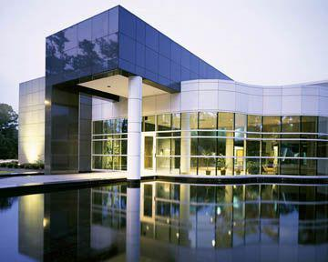
Forensics
Forensics Biological Laboratory Capabilities
I. Chemistry - A chemistry unit is used to test samples of blood and urine for alcohol, drugs and poisoning and in the analysis of synthetic materials such as medicines, dyes and stains.
CREST Research Center- Wilmington, NC
Equipment:
a. gas chromatographs
b. mass spectrometers
c. Fume cupboards and
analytical balances
d. High powered microscopes
e. Laboratory Incubators
( including C02 incubators)
f. Audio and visual equipment
g. Thermal Cyclers
h. Computers and data
processors
l. Laboratory Centrifuges
SENSITIVE – PROPRIETARY INFORMATION

Slide 47
Forensics
Forensics Biological Laboratory Capabilities
II. Serology Unit - specializes in the identification and analysis of bloodstains and other bodily fluids, and DNA sequencing. The most common DNA tests are the polymerse chain reaction and analysis of mitochondrial DNA.
Equipment: a. Megacycler b. DNA sequencer
III. Materials Unit - used to identify and analyze metals, paints, ceramics, soil, seeds, plants and wood in an attempt to trace a crime back to a possible suspect.
Equipment: Microscope
SENSITIVE – PROPRIETARY INFORMATION

Slide 48
Forensics
Forensics Biological Laboratory Capabilities
IV. Firearms - Firearms units test weapons to see which weapon made the mark on an object or wounded or killed a person. Firearms specialists study the used bullet cartridges and use shooting baths to fire weapons, identify the bullet marks and establish the firing distance.
Equipment: a. Firearm test unit b. Atomic Absorption Spectroscopy
V. Face Recognition Technology
Equipment: E-Fit (computerized system)
SENSITIVE – PROPRIETARY INFORMATION

Slide 49
Thank You
Questions??
Contact Information
Phone:855-367-7739
Email: Sperry@ospreygs.com
SENSITIVE – PROPRIETARY INFORMATION

